Slide 1

Alphabet

Slide 2
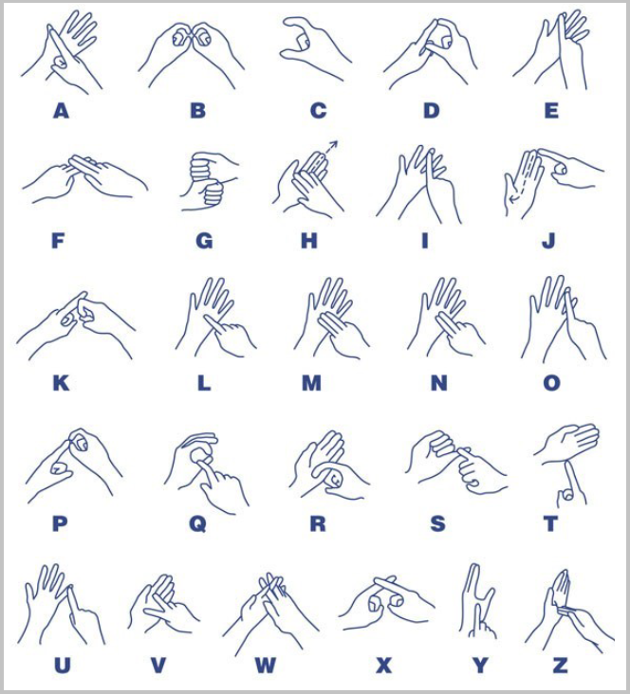

Slide 3
Vowels

Slide 9
Can you sign your name?

